Slide 1
AIR QUALITY

Slide 2
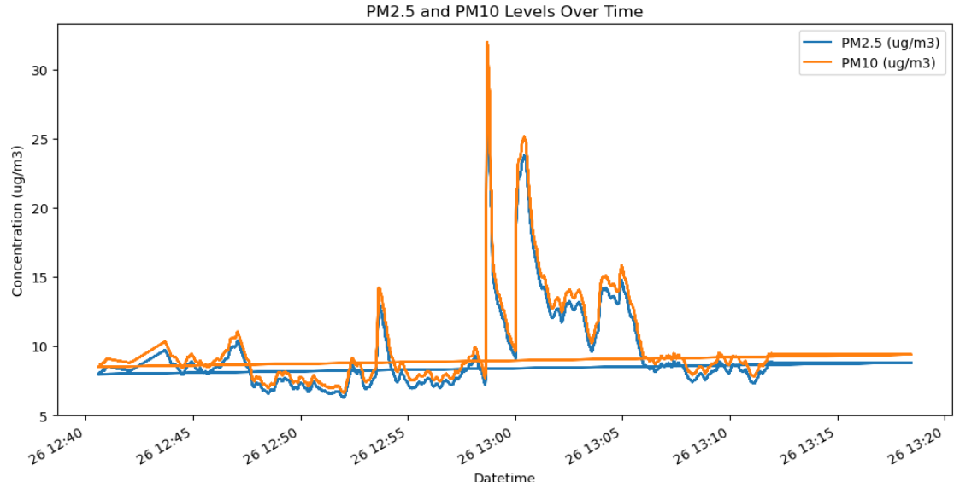
Sensor Data

Slide 3
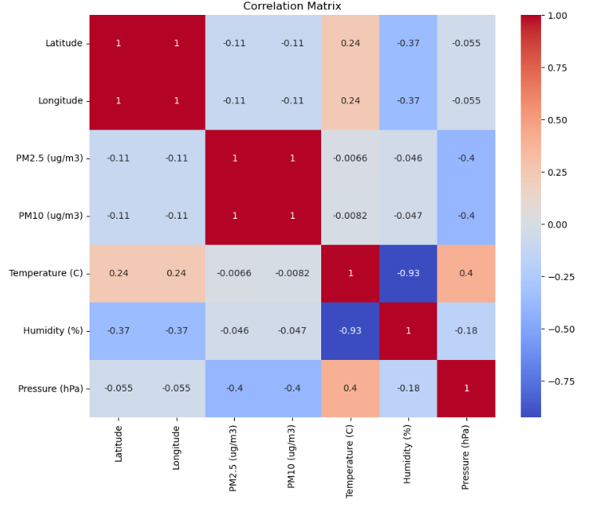
Analyze Correlations
Find correlations between variables like PM2.5, PM10, Temperature, Humidity, and Pressure.

Slide 4
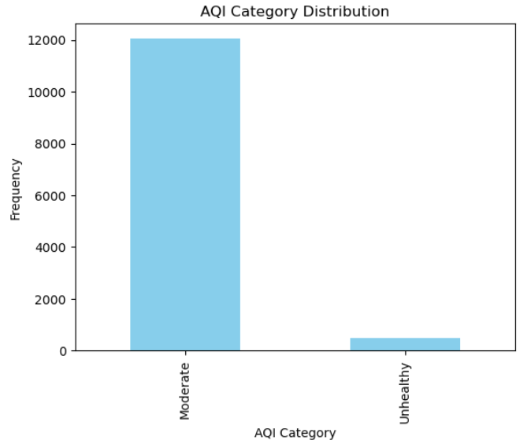
Time-Series Decomposition

Slide 5
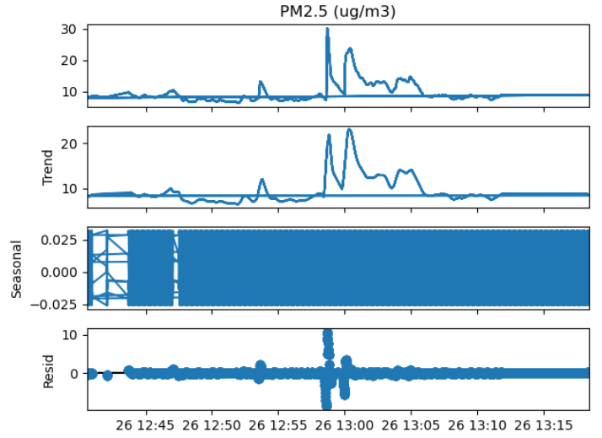
Time-Series Decomposition

Slide 7
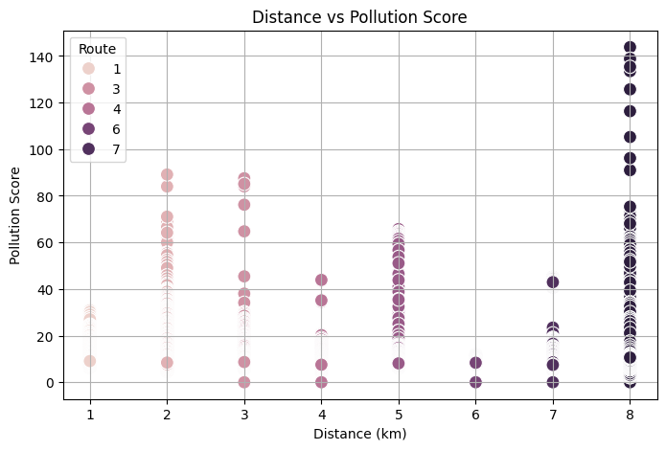
Route Optimization
Routes with shorter distances may not always have lower pollution scores, as pollution is more influenced by local environmental factors.
Travel times are inversely proportional to speed, assuming a consistent road condition.

Slide 8
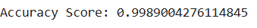
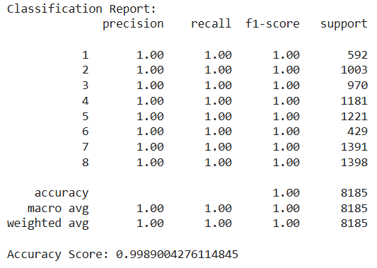
Random Forest Classifier Model

Slide 9

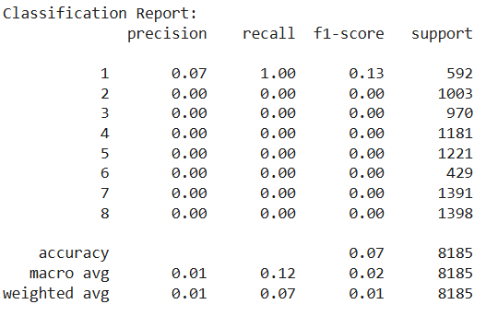
NEURAL NETWORK MODEL

Slide 10
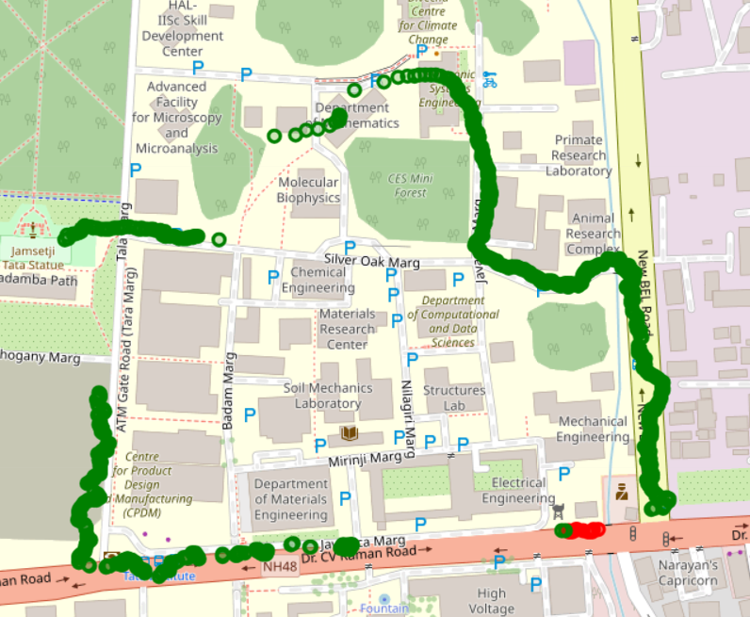
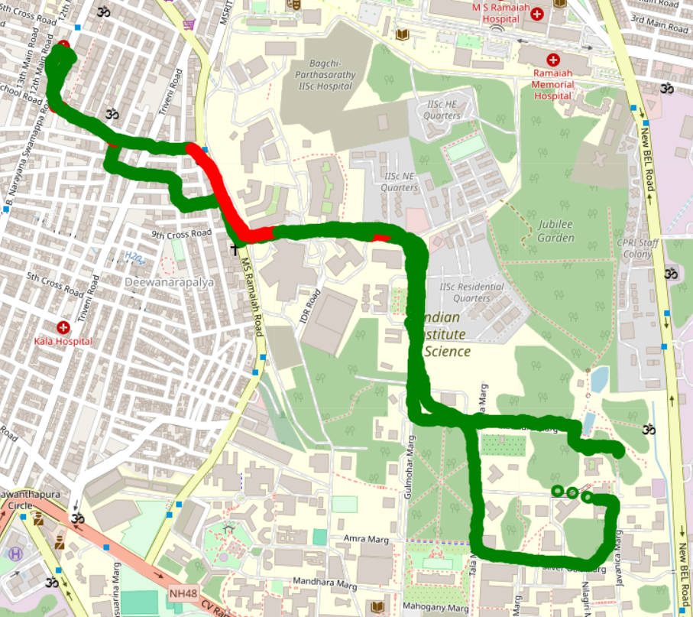
R 1
R 2

Slide 11
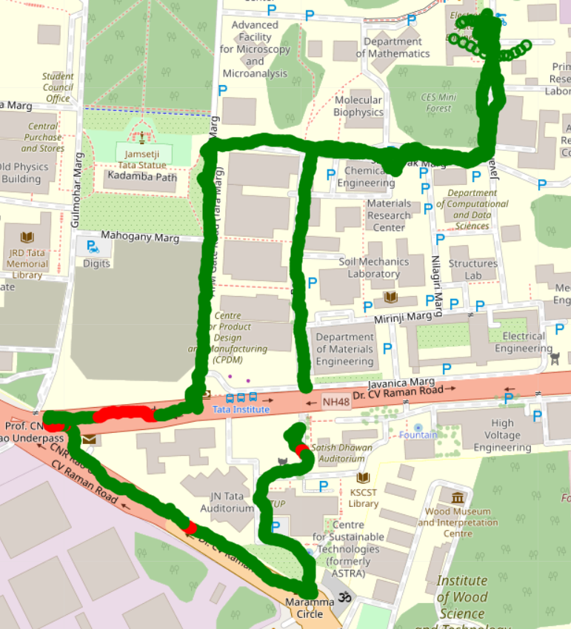
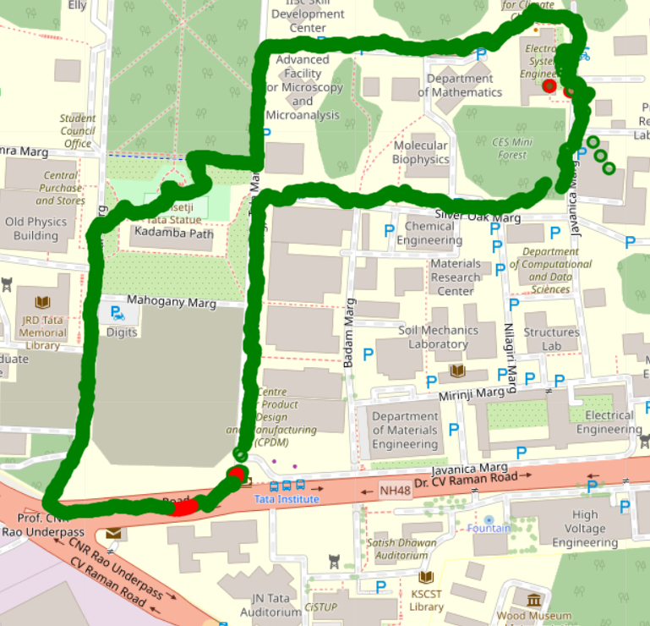
R 3
R 4

Slide 12
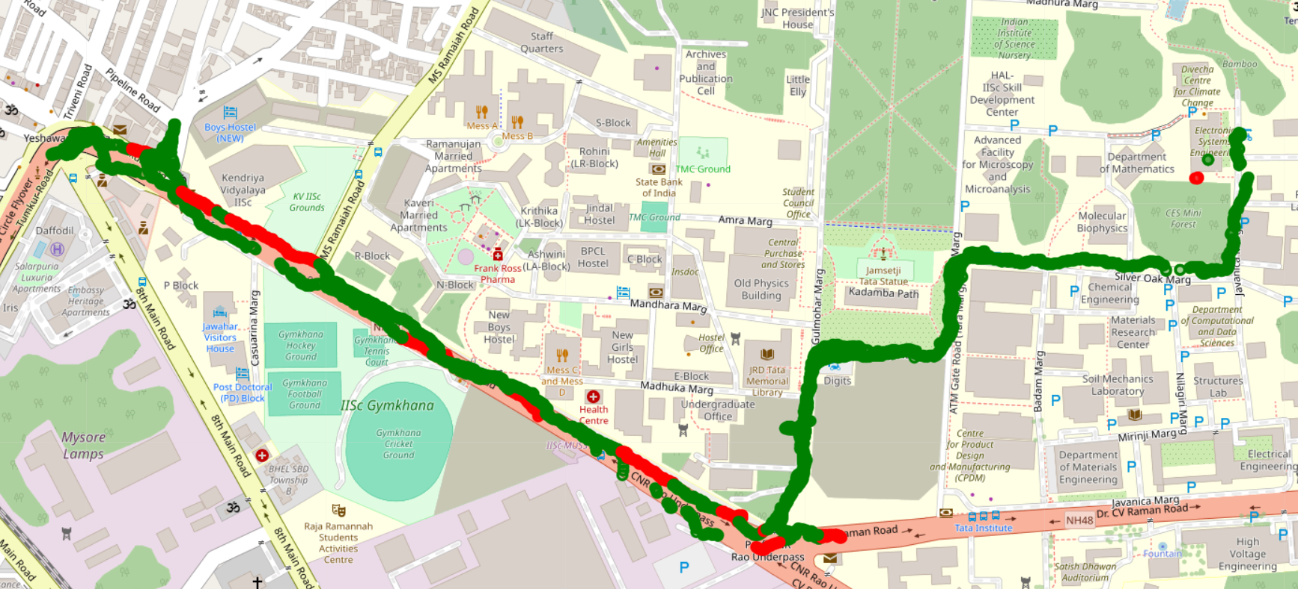
R 5

Slide 13
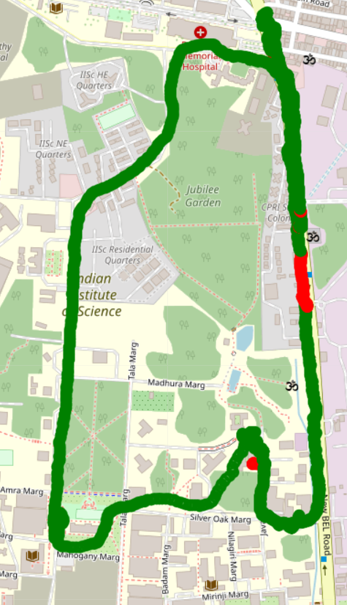
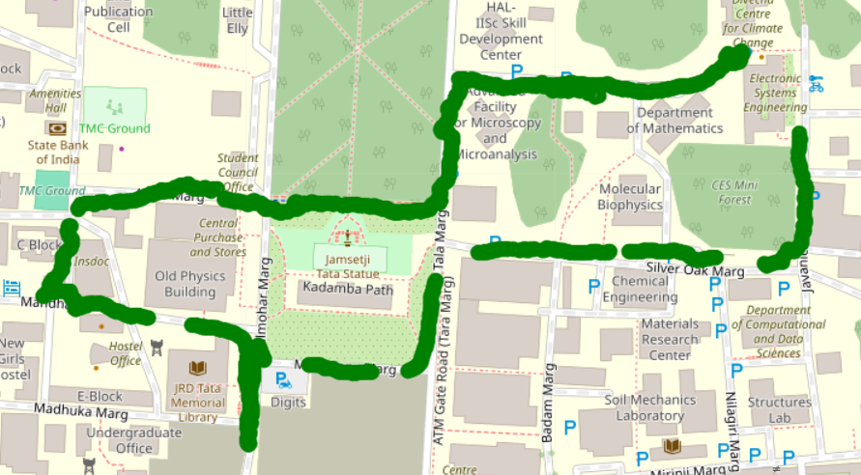
R 7
R 6

Slide 14
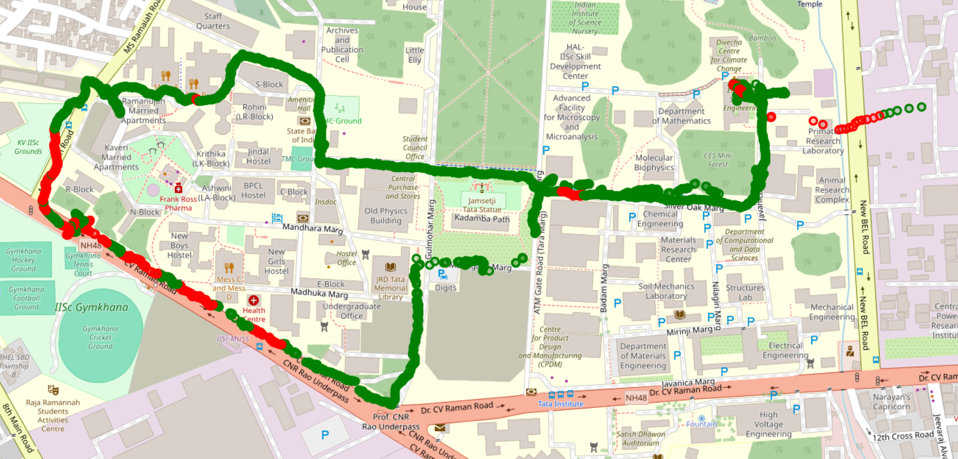
R 8

Slide 15
Route Optimization
Multi-Criteria Decision Making (MCDM)

